Slide 1
Capstone Design
Team 3
20163704
20161344
20164245
Park JuHyeon
Heo JeongWoo
Hong Jin

Slide 2
Contents
1.
Feedback
Progress
Schedule
Q&A
2.
3.
4.

Slide 3
1.
Q&A Feedback

Slide 4
1
Q&A Feedback
Feedback
Keyword Recommendation
It would be nice to have a recommendation for input text in the lasso function.

Slide 5
1
Q&A Feedback
Feedback
We will implement Keyword Recommendation such as “dictionary.”
And all Keywords will be written in the manual.

Slide 6

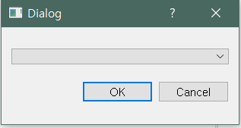
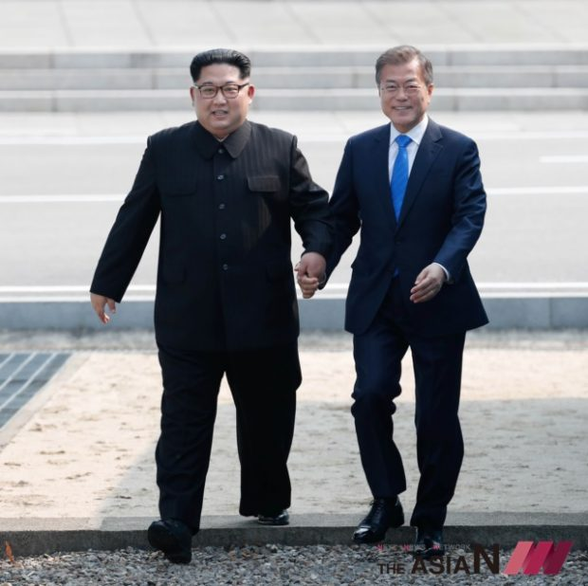
1
Q&A Feedback
Keyword Recommendation Scenario
file
example 1
example 2
Main
Sub

Slide 7

1
Q&A Feedback
Keyword Recommendation Scenario
B
Bicycle
Bus
Boat
Bench
Bird
Bear
…
…
…
…
…

Slide 8
1
Q&A Feedback
Keyword Recommendation Scenario
Be
Bench
Bear
…
…
…
…
…

Slide 9
1
Q&A Feedback
Keyword Recommendation Scenario
Bench
Bench
Implement C++ code, Not apply QT yet

Slide 10

1
Q&A Feedback
Keyword Recommendation Scenario

Slide 11
1
Q&A Feedback
Keyword Recommendation Scenario
KeywordList.html
Airplane
Apple
Backpack
Banana
Bear
Bed
Car
Cat
Person
…..
…..

Slide 12
2.
Progress

Slide 13
2.1
Dataset & Category

Slide 14

2
Progress
Dataset & Category
MS COCO 2017 Train Images
-> 118K Image & 91 Category

Slide 15
2
Progress
Dataset & Category
Animal <Super Category>
Bird
Cat
Dog
Horse
Sheep
Cow
Elephant
Bear
Zebra
Giraffe
(Animal include these)
We use Category & Super Category
-> 91 Category & 12 Super Category

Slide 16
2
Progress
Dataset & Category
<Super Category>
Accessory
Animal
Appliance
Electronic
Food
Furniture
Indoor
Kitchen
Outdoor
Person
Sports
Vehicle
If we need more dataset,
We will add Specific dataset later.
Ex) Watch …

Slide 17
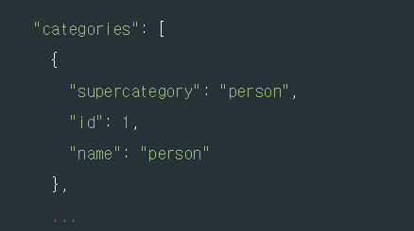
2
Progress
Dataset & Category
We collect category list from Instances json file
This file has ‘super category’ & ‘name’

Slide 18
2.2
Basic Function & Simple UI

Slide 19
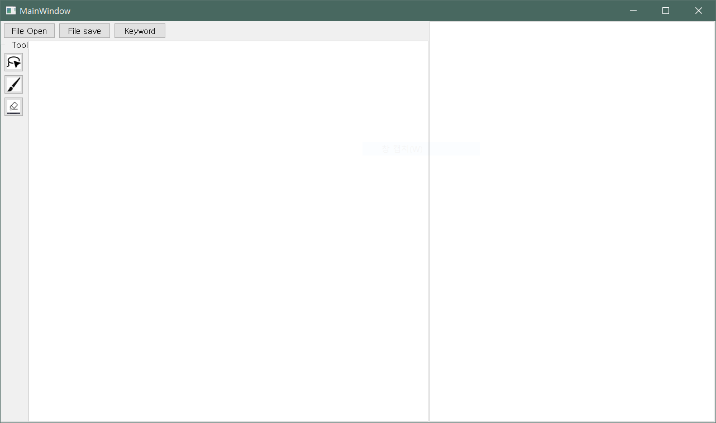
2
Progress
Basic Function & UI
Basic Function & Simple UI - QT

Slide 20
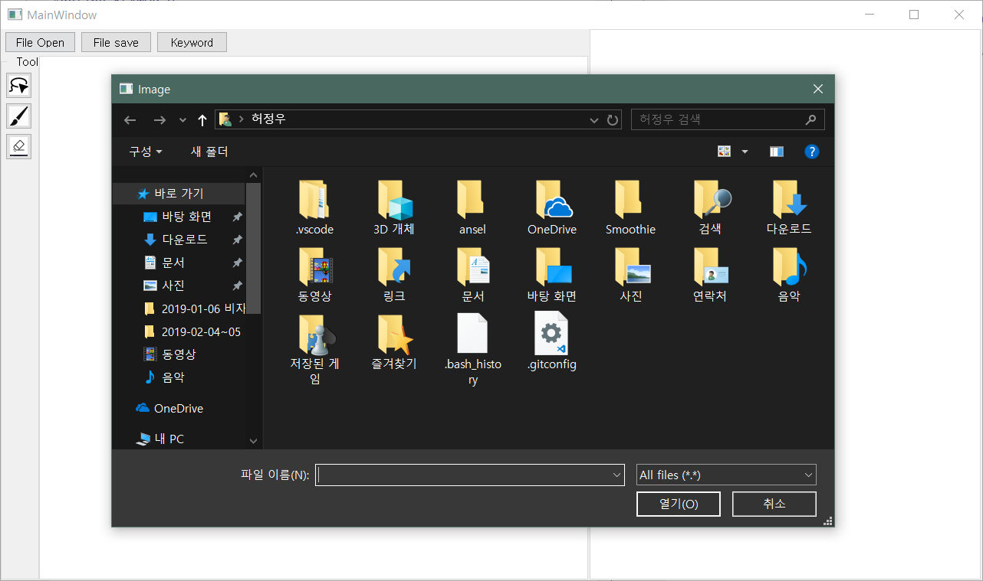
2
Progress
Basic Function & UI
Click File Open

Slide 21
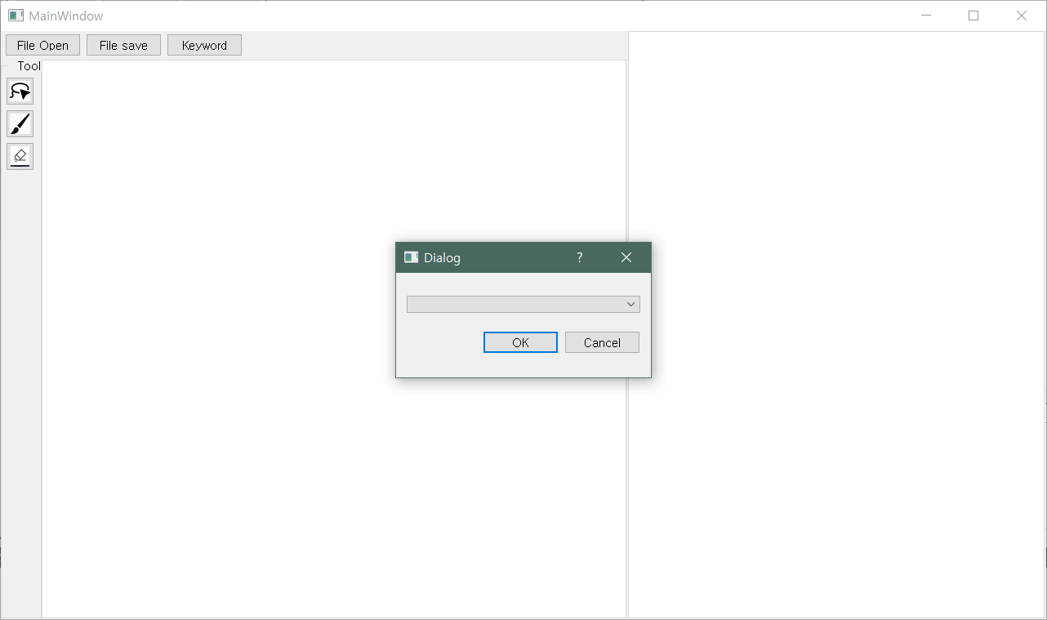
2
Progress
Basic Function & UI
Click Lasso Function

Slide 22
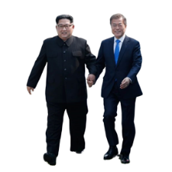

2
Progress
Basic Function & UI
Something to think about…
file
example 1
example 2
person
How to implement Tabs or Layers
How to implement & position Custom Widget
Unfamiliar with using QT..
Main
Sub

Slide 23
2.3
Deep Learning Models

Slide 24
2
Progress
Detection Model
CPU : Intel i5 – 4600
RAM : 16Gb
Graphic Card : GTX 1080 Ti
HDD : 500Gb
Last Week….
We have Poor development environment for Deep Learning

Slide 25

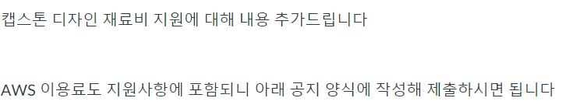
2
Progress
Detection Model
CPU : Intel i5 – 4600
RAM : 16Gb
Graphic Card : GTX 1080 Ti
HDD : 500Gb
3/26 – Upload Notice

Slide 26
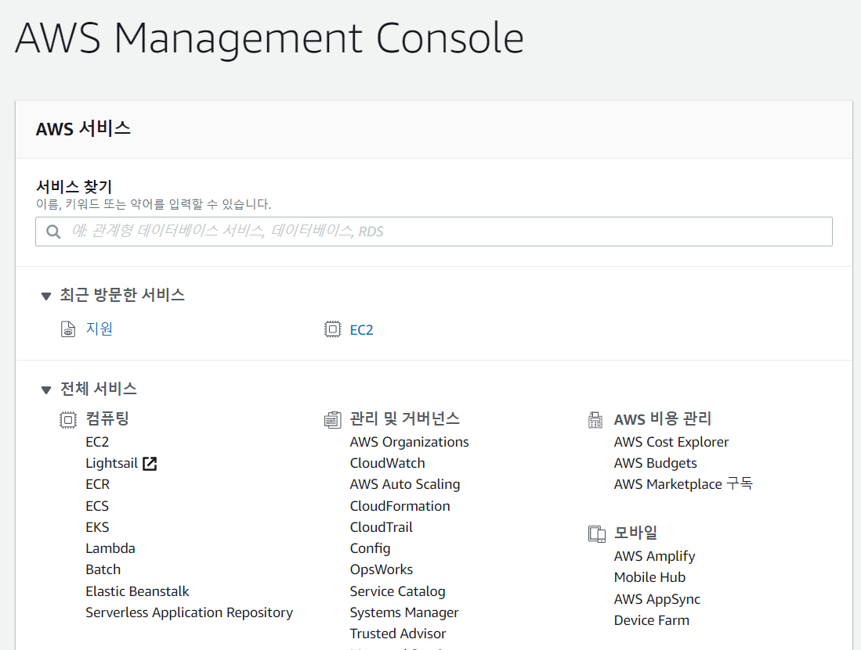
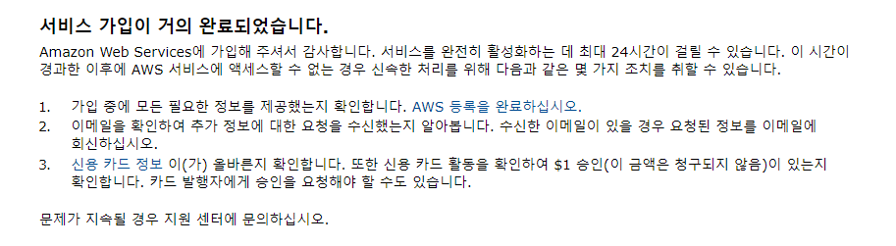
2
Progress
Detection Model
3/27 – Try to use AWS EC2

Slide 27
2
Progress
Detection Model
3/28 – After 24 hours….?

Slide 28
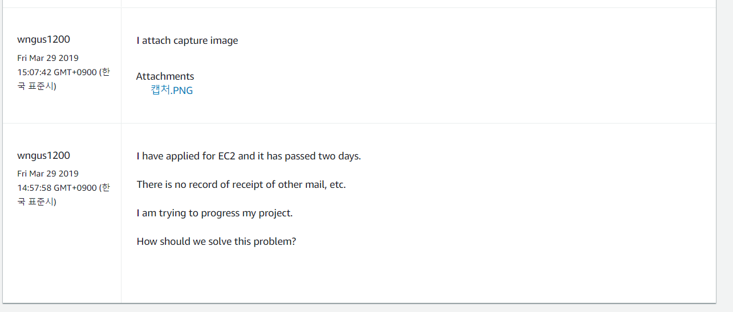
2
Progress
Detection Model
3/29 – Help….Support Center….

Slide 29
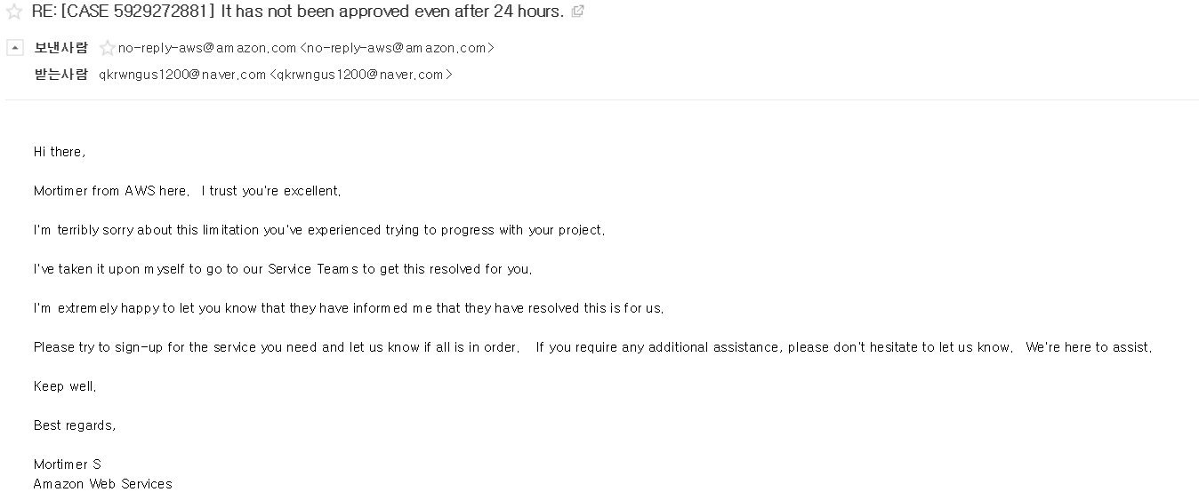
2
Progress
Detection Model
3/30 – Thanks to Mortimer

Slide 30
2
Progress
Detection Model
3/30 – Thanks to Mortimer

Slide 31
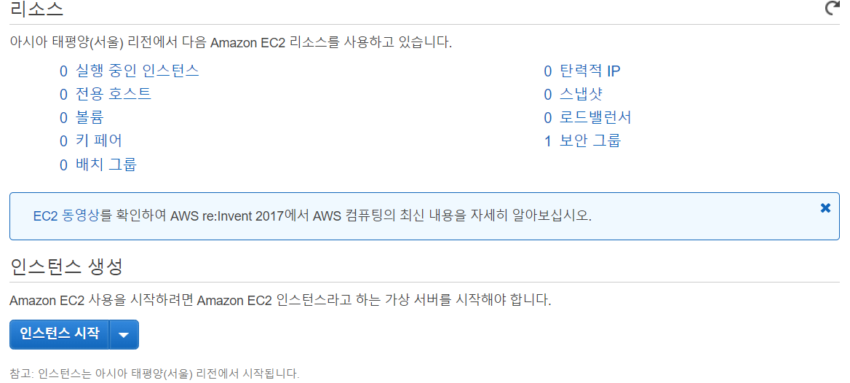
2
Progress
Detection Model
3/31 – Finally, I can use AWS
Therefore, Detail setting & Detection model will be announced next week!

Slide 32
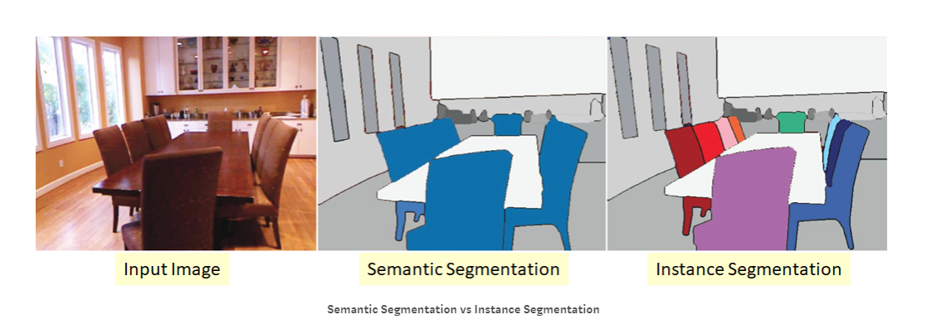
2
Progress
Segmentation
Semantic Segmentation : Identify the object category of each pixel for every known object within an image. Labels are class-aware.
Instance Segmentation : Identify each object instance of each pixel for every known object within an image. Labels are instance-aware.

Slide 33
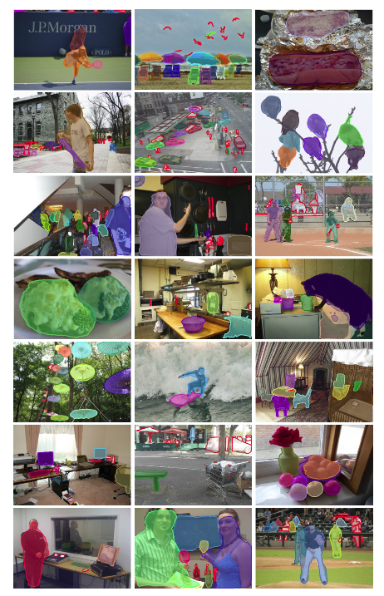
2
Progress
Segmentation
We decide to use Instance Segmentation
This is suitable for our Lasso Function!

Slide 34
3.
Schedule

Slide 35
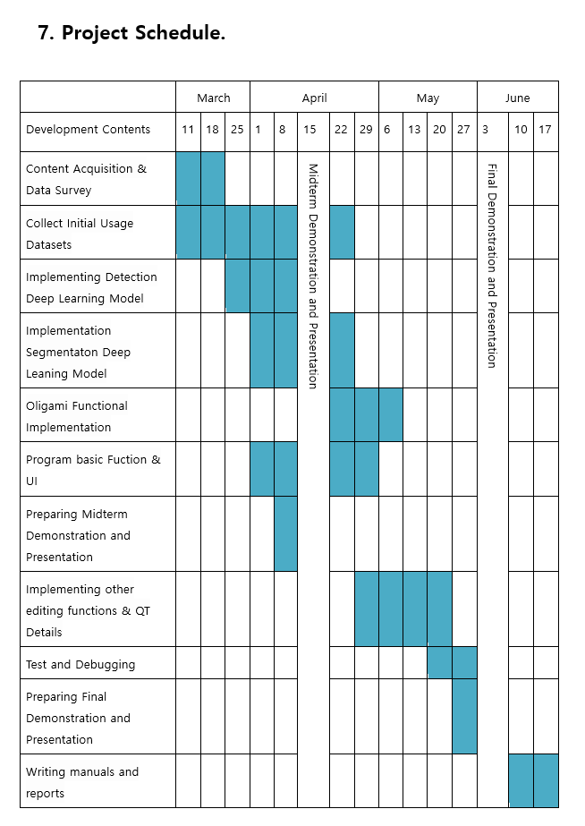
3
Total Schedule

Slide 36
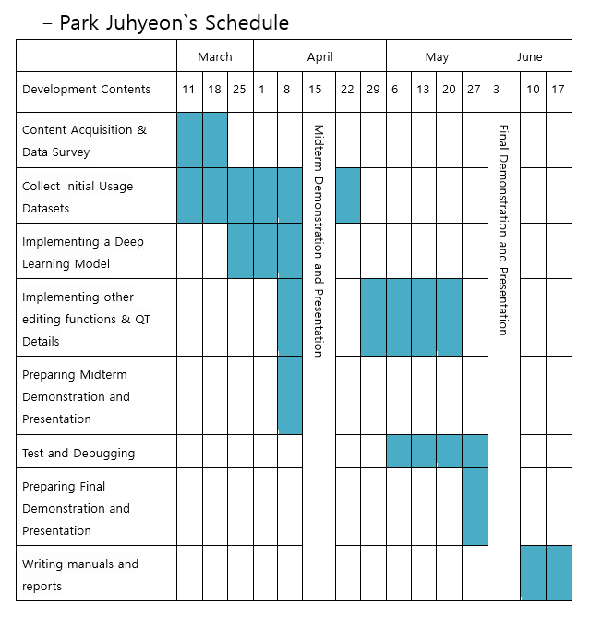
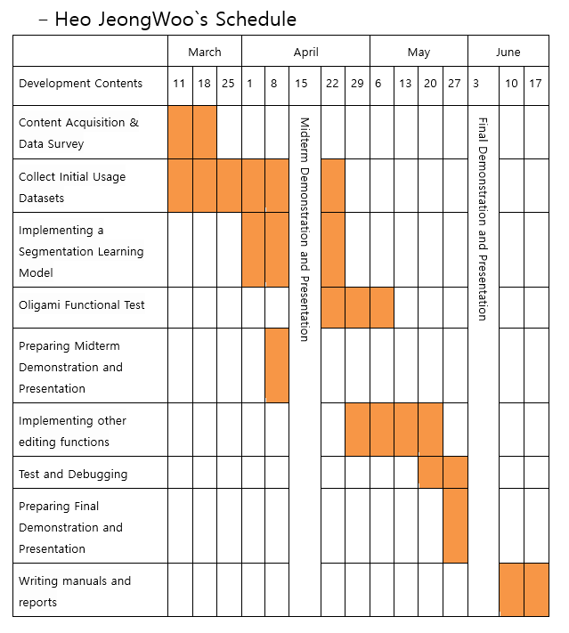
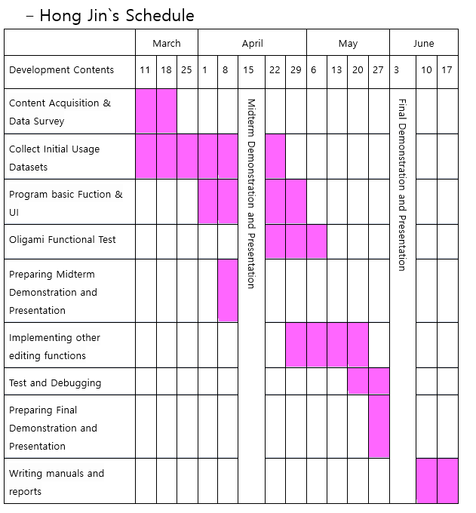
3
Schedule

Slide 37
4.
Q&A

